Slide 1
Numpy : Submodules

Slide 2
Data Types
String Functions
Sort, Search & Counting Functions
NDArray
Array Creation Routines
Array From Existing Data
Array From Numerical Ranges
Iterating Over Array (numpy.nditer)
Array Manipulation
Array Attributes
Broadcasting
Matrix Library (numpy.matlib)
Copies & Views
Linear Algebra (numpy.linalg)
Mathematical Functions
Arithmetic Operations
Statistical Functions
Indexing & Slicing
F2py is a tool that provides an easy connection between Python and Fortran languages. F2py is part of NumPy. It creates extension modules from (handwritten or f2py generated) signature files or directly from Fortran sources.
import numpy.f2py
import numpy.f2py as myf2py
19. Advanced Indexing (Integer & Boolean)
20. Matplotlib (from matplotlib import pyplot as plt)
21. Histogram (numpy.histogram)
22. I/O with NumPy

Slide 3
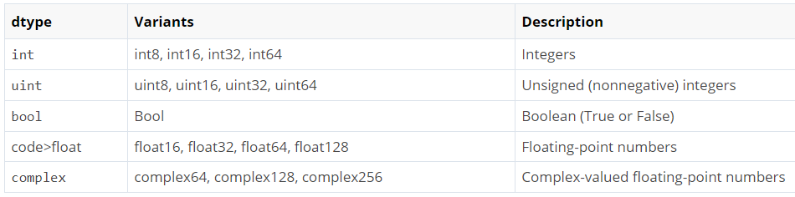
Data Type Objects (dtype)
1. NumPy - Data Types
Each built-in data type has a character code that uniquely identifies it.
'b' − boolean
'i' − (signed) integer
'u' − unsigned integer
'f' − floating-point
'c' − complex-floating point
'm' − timedelta
'M' − datetime
'O' − (Python) objects
'S', 'a' − (byte-)string
'U' − Unicode
'V' − raw data (void)
Data Types Supported by NumPy
The dtype method determines the datatype of elements stored in NumPy array. You can also explicitly define the data type using the dtype option as an argument of array function.

Slide 4
numpy.char
2. NumPy - String Functions
Sr.No. | Function & Description
1 | add() Returns element-wise string concatenation for two arrays of str or Unicode
2 | multiply() Returns the string with multiple concatenation, element-wise
3 | center() Returns a copy of the given string with elements centered in a string of specified length
4 | capitalize() Returns a copy of the string with only the first character capitalized
5 | title() Returns the element-wise title cased version of the string or unicode
6 | lower() Returns an array with the elements converted to lowercase
7 | upper() Returns an array with the elements converted to uppercase
8 | split() Returns a list of the words in the string, using separatordelimiter
9 | splitlines() Returns a list of the lines in the element, breaking at the line boundaries
10 | strip() Returns a copy with the leading and trailing characters removed
11 | join() Returns a string which is the concatenation of the strings in the sequence
12 | replace() Returns a copy of the string with all occurrences of substring replaced by the new string
13 | decode() Calls str.decode element-wise
14 | encode() Calls str.encode element-wise

Slide 5
3. NumPy - Sort, Search & Counting Functions
numpy.sort()
numpy.sort(a, axis, kind, order)
numpy.argsort()
numpy.lexsort()
numpy.argmax() and numpy.argmin()
numpy.nonzero()
numpy.where()
numpy.extract()

Slide 6
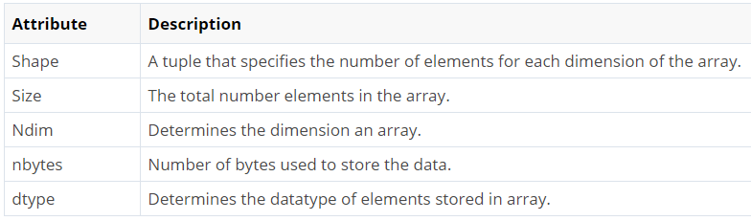
4. NumPy - Ndarray Object
numpy.array
numpy.array(object, dtype = None, copy = True, order = None, subok = False, ndmin = 0)
The main data structure for multidimensional arrays in NumPy is the ndarray class. Basic Attributes of the ndarray Class as follow:

Slide 7
Sr.No. | Parameter & Description
1 | object Any object exposing the array interface method returns an array, or any (nested) sequence.
2 | dtype Desired data type of array, optional
3 | copy Optional. By default (true), the object is copied
4 | order C (row major) or F (column major) or A (any) (default)
5 | subok By default, returned array forced to be a base class array. If true, sub-classes passed through
6 | ndmin Specifies minimum dimensions of resultant array

Slide 8
ndim: You can find the dimension of the array, whether it is a two-dimensional array or a single dimensional array. So, let us see this practically how we can find the dimensions. In the below code, with the help of ‘ndim’ function, I can find whether the array is of single dimension or multi dimension. Let us implement it practically.
import numpy as np
a = np.array([(1,2,3),(4,5,6)])
Print(a.ndim)
Output : 2
import numpy as np
a = np.array([(1,2,3)])
Print(a.dtype)
Output : int32
dtype: You can find the data type of the elements that are stored in an array. So, if you want to know the data type of a particular element, you can use ‘dtype’ function which will print the datatype along with the size. In the below code, I have defined an array where I have used the same function. Let us implement it practically:
https://www.quora.com/What-are-the-use-cases-for-NumPy

Slide 9
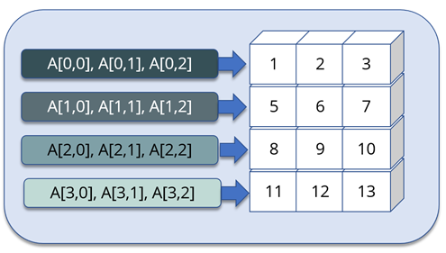
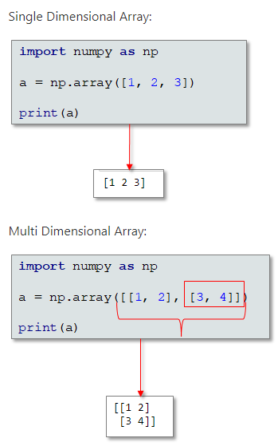
The ndarray (NumPy Array) is a multidimensional array used to store values of same datatype. These arrays are indexed just like Sequences, starts with zero.

Slide 10
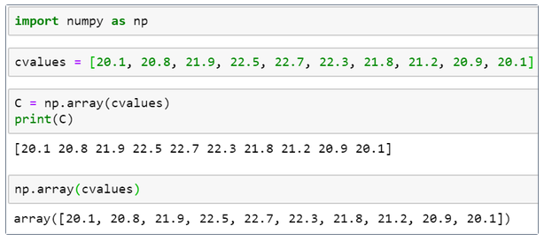
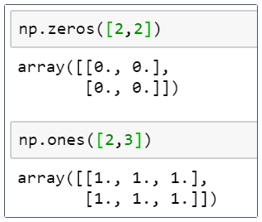
NumPy is often used to play around with arrays. Here is an example to create an array and display its values:
To create a numpy array only zeros and ones, use the following:

Slide 11
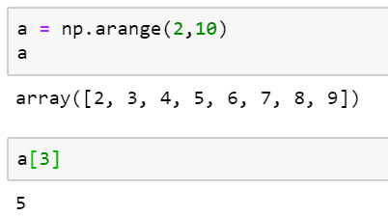
The arange function is used to generate values that are evenly spaced within a defined interval.
You can subset the values in an array using the index positions:

Slide 12
5. NumPy - Array Creation Routines
A new ndarray object can be constructed by any of the following array creation routines or using a low-level ndarray constructor.
numpy.empty
numpy.empty(shape, dtype = float, order = 'C')
numpy.zeros
numpy.zeros(shape, dtype = float, order = 'C')
numpy.ones
numpy.ones(shape, dtype = None, order = 'C')

Slide 13
6. NumPy - Array From Existing Data
numpy.asarray
numpy.asarray(a, dtype = None, order = None)
numpy.frombuffer
numpy.frombuffer(buffer, dtype = float, count = -1, offset = 0)
numpy.fromiter
numpy.fromiter(iterable, dtype, count = -1)

Slide 14
7. NumPy - Array From Numerical Ranges
numpy.arrange
numpy.arange(start, stop, step, dtype)
numpy.linspace
numpy.linspace(start, stop, num, endpoint, retstep, dtype)
numpy.logspace
numpy.logspace(start, stop, num, endpoint, base, dtype)

Slide 15
8. NumPy - Iterating Over Array
NumPy package contains an iterator object numpy.nditer. It is an efficient multidimensional iterator object using which it is possible to iterate over an array. Each element of an array is visited using Python’s standard Iterator interface.
Iteration Order
Modifying Array Values
External Loop
Broadcasting Iteration

Slide 16
9. NumPy - Array Manipulation
Changing Shape
Sr.No. | Shape & Description
1 | Reshape Gives a new shape to an array without changing its data
2 | Flat A 1-D iterator over the array
3 | Flatten Returns a copy of the array collapsed into one dimension
4 | Ravel Returns a contiguous flattened array
Transpose Operations
Sr.No. | Operation & Description
1 | Transpose Permutes the dimensions of an array
2 | ndarray.T Same as self.transpose()
3 | Rollaxis Rolls the specified axis backwards
4 | Swapaxes Interchanges the two axes of an array

Slide 17
Changing Dimensions
Sr.No. | Dimension & Description
1 | Broadcast Produces an object that mimics broadcasting
2 | broadcast_to Broadcasts an array to a new shape
3 | expand_dims Expands the shape of an array
4 | squeeze Removes single-dimensional entries from the shape of an array
Joining Arrays
Sr.No. | Array & Description
1 | Concatenate Joins a sequence of arrays along an existing axis
2 | Stack Joins a sequence of arrays along a new axis
3 | Hstack Stacks arrays in sequence horizontally (column wise)
4 | Vstack Stacks arrays in sequence vertically (row wise)

Slide 18
Splitting Arrays
Sr.No. | Array & Description
1 | Split Splits an array into multiple sub-arrays
2 | Hsplit Splits an array into multiple sub-arrays horizontally (column-wise)
3 | Vsplit Splits an array into multiple sub-arrays vertically (row-wise)
Adding / Removing Elements
Sr.No. | Element & Description
1 | Resize Returns a new array with the specified shape
2 | Append Appends the values to the end of an array
3 | Insert Inserts the values along the given axis before the given indices
4 | Delete Returns a new array with sub-arrays along an axis deleted
5 | Unique Finds the unique elements of an array

Slide 19
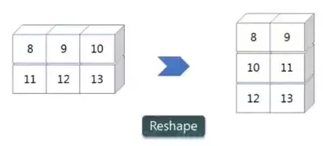
Reshape
Reshape is when you change the number of rows and columns which gives a new view to an object. An example to reshape the below array.
We have 3 columns and 2 rows which has converted into 2 columns and 3 rows. Let me show you practically how it’s done.
import numpy as np
a = np.array([(8,9,10),(11,12,13)])
print(a)
a = a.reshape(3,2)
print(a)
OUTPUT : [[8 9 10] [11 12 13]] [[8 9] [10 11] [12 13]]

Slide 20
10. NumPy - Array Attributes
ndarray.shape
ndarray.ndim
numpy.itemsize
numpy.flags

Slide 21
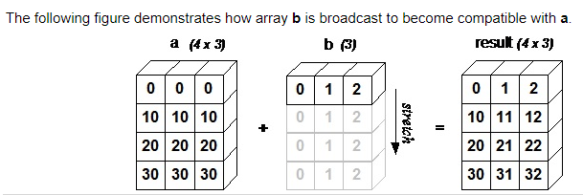
11. NumPy - Broadcasting
The term broadcasting refers to the ability of NumPy to treat arrays of different shapes during arithmetic operations. Arithmetic operations on arrays are usually done on corresponding elements. If two arrays are of exactly the same shape, then these operations are smoothly performed.

Slide 22
13. NumPy - Copies & Views
No Copy
Simple assignments do not make the copy of array object. Instead, it uses the same id() of the original array to access it. The id() returns a universal identifier of Python object, similar to the pointer in C.
Furthermore, any changes in either gets reflected in the other. For example, the changing shape of one will change the shape of the other too.
View or Shallow Copy
NumPy has ndarray.view() method which is a new array object that looks at the same data of the original array. Unlike the earlier case, change in dimensions of the new array doesn’t change dimensions of the original.
Deep Copy
The ndarray.copy() function creates a deep copy. It is a complete copy of the array and its data, and doesn’t share with the original array.

Slide 23
15. NumPy – Mathematical Operations
16. NumPy - Arithmetic Operations
17. NumPy - Statistical Functions
Trigonometric Functions
np.sin
np.cos
np.tan
np.degrees
np.arcsin(sin) [Inverse of sin]
np.arccos(cos) [Inverse of cos]
np.arctan(tan) [Inverse of tan]
numpy.around()
numpy.floor()
numpy.ceil()
numpy.add()
numpy. subtract()
numpy. multiply()
numpy. divide()
numpy.reciprocal()
numpy.power()
numpy.mod() or numpy.remainder()
numpy.real()
numpy.imag()
numpy.conj()
numpy.angle()
Function | Numpy
Min | np.min()
Max | np.max()
Mean | np.mean()
Median | np.median()
Standard deviation | np.std()
np.amin( )
np.amax( )
np.ptp()
np.percentile()
np.average()
Variance
arcsin, arcos, and arctan functions return the trigonometric inverse of sin, cos, and tan of the given angle

Slide 24
20. NumPy - Matplotlib
1. pyplot( ) is the most important function in matplotlib library, which is used to plot 2D data.
a. plot( ) function of pyplot submodule of matplotlib package.
b. subplot( )
c. bar( ) function of pyplot submodule used to generate bar graphs.
import numpy as np
from matplotlib import pyplot as plt
# Plot the points using matplotlib
plt.plot(x, y)
plt.show()

Slide 25
21. NumPy - Histogram Using Matplotlib
NumPy has a numpy.histogram() function that is a graphical representation of the frequency distribution of data. Rectangles of equal horizontal size corresponding to class interval called bin and variable height corresponding to frequency.
numpy.histogram( )
plt( )
import numpy as np
a = np.array([22,87,5,43,56,73,55,54,11,20,51,5,79,31,27])
np.histogram(a,bins = [0,20,40,60,80,100])
hist,bins = np.histogram(a,bins = [0,20,40,60,80,100])
print hist
print bins
from matplotlib import pyplot as plt
import numpy as np
a = np.array([22,87,5,43,56,73,55,54,11,20,51,5,79,31,27])
plt.hist(a, bins = [0,20,40,60,80,100])
plt.title("histogram")
plt.show()

Slide 26
22. I/O with NumPy
The ndarray objects can be saved to and loaded from the disk files. The IO functions available are −
• load() and save() functions handle /numPy binary files (with npy extension)
• loadtxt() and savetxt() functions handle normal text files
NumPy introduces a simple file format for ndarray objects. This .npy file stores data, shape, dtype and other information required to reconstruct the ndarray in a disk file such that the array is correctly retrieved even if the file is on another machine with different architecture.
numpy.save( )
The numpy.save() file stores the input array in a disk file with npy extension.
savetxt( )
The storage and retrieval of array data in simple text file format is done with savetxt() and loadtxt() functions.

